Slide 1
Restaurants Of Tunis

Slide 2
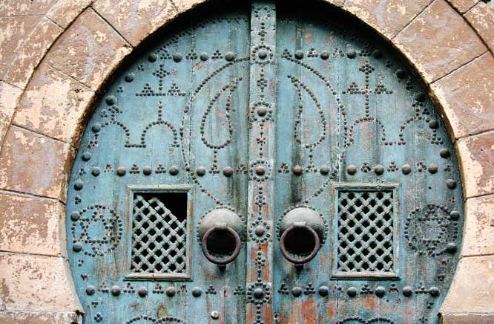
Restaurants - La Medina

Slide 3
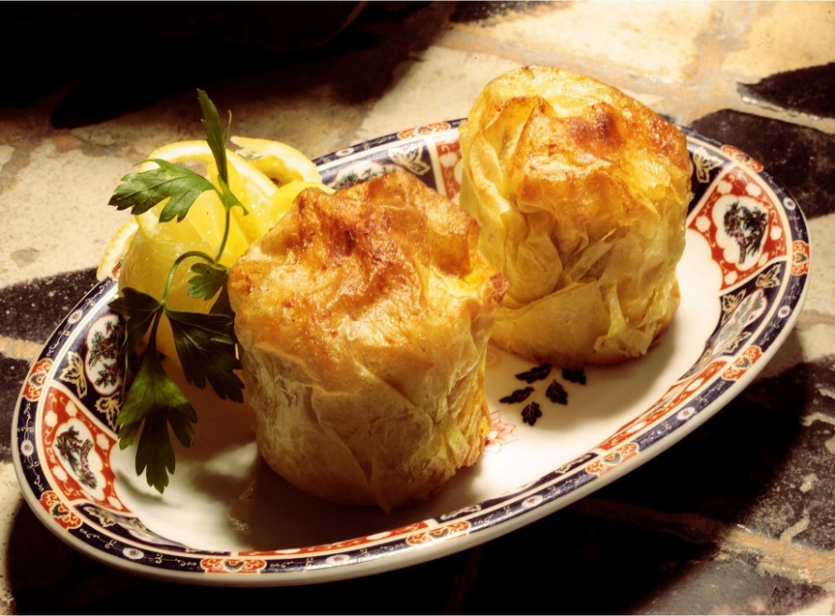
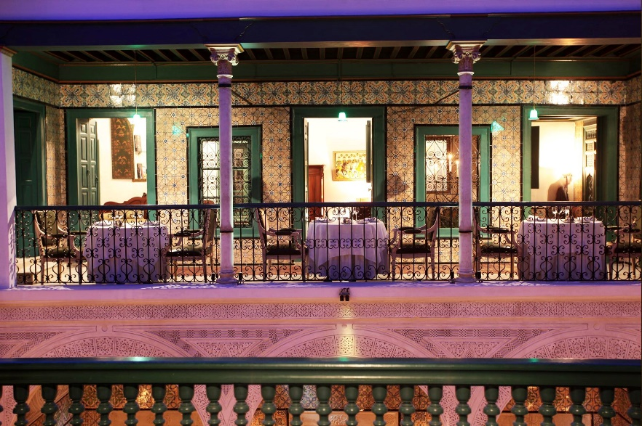
Dar El Jeld, Tunis
An exceptional setting of an old house, walls covered with traditional ceramic tiles, the ceiling is covered in real lace. Balconies and small saloons overlooking a patio.
Dar el Jeld offers typical refined Tunisian cuisine.
Open from Monday to Saturday between 13:30 and 00:00 and reservation is a must.
Address: Rue Dar El Jeld, Tunis Tel: +216 71 560 916
Distance: 40 minutes drive
Dress code: Smart casual

Slide 4
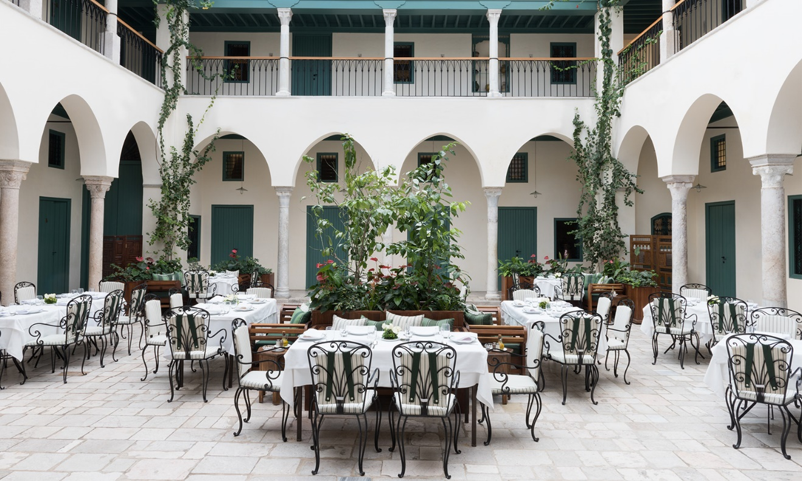
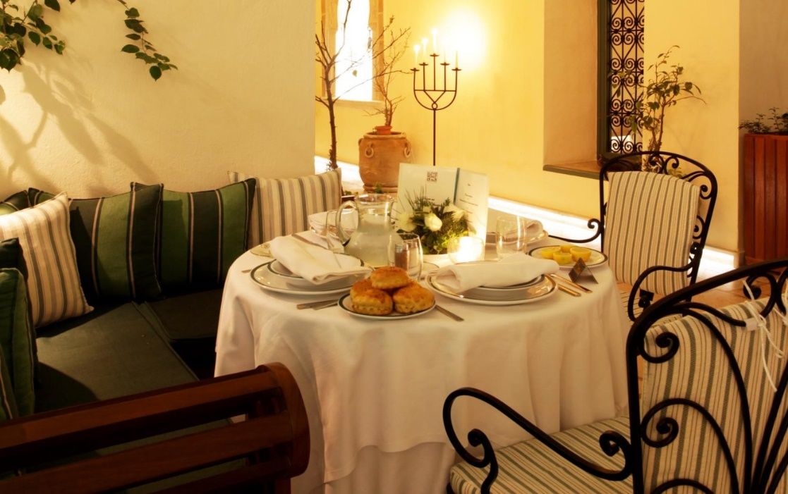
Fondouk El Attarine
At the heart of the souks, a caravanserai rehabilated to a house of crafts and restaurant.
Fondouk El Attarine serves typical traditional Tunisian food.
Open everyday except Sunday between 10:00 and 18:00
Reservation is a must.
Address: Souk El Attarine, Tunis La Medina
Tel: +216 71 322 244
Distance: 40 minutes drive
Dress Code: Smart Casual

Slide 5
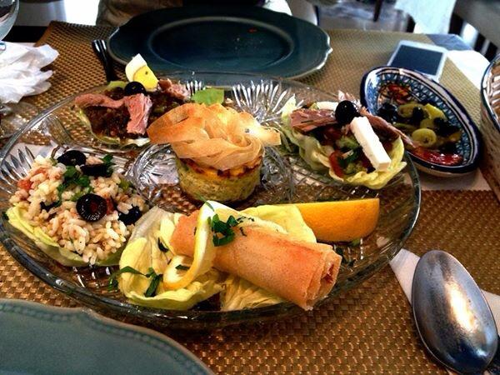
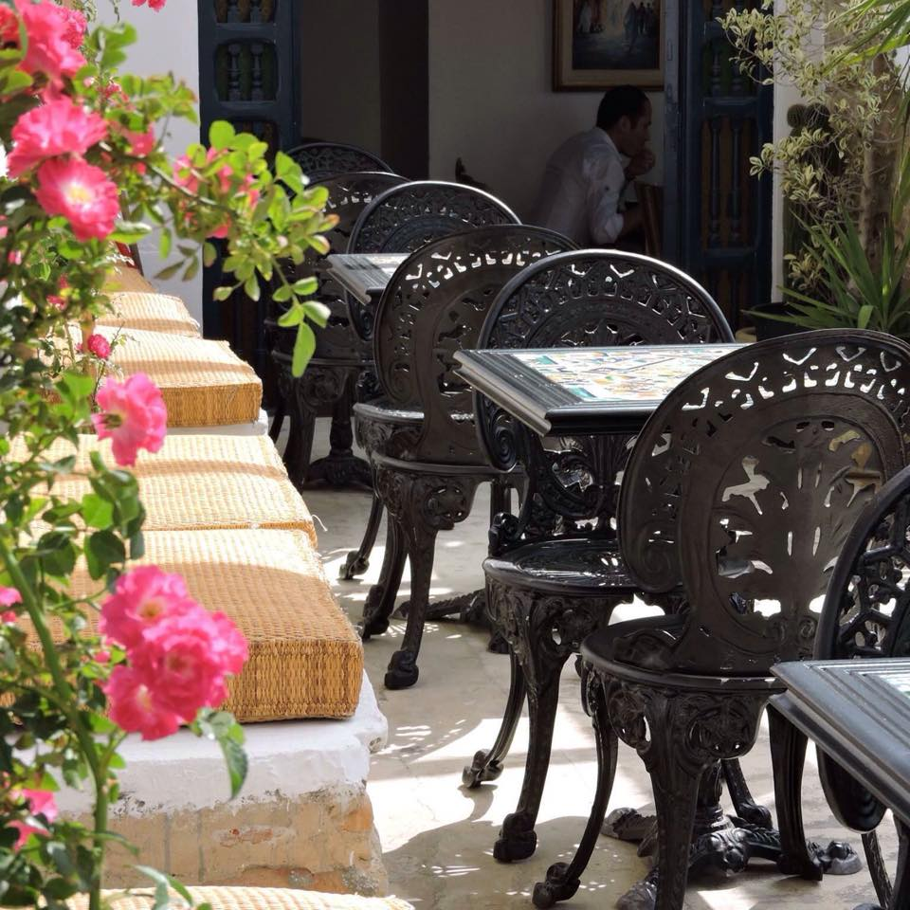
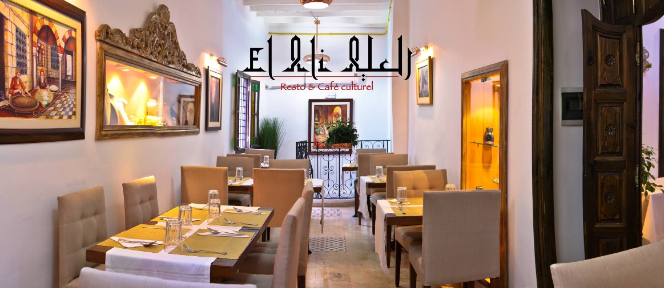
El Ali, La Medina, Tunis
El Ali is a result of transformation from a burned down residential building to a venue where culture, nostalgic charm and modern comfort live in harmony, serving typical traditional Tunisian gastronomy.
Open from Monday to Saturday between 13:30 and 22:00.
Reservation is a must.
Address: 45 Bis Rue Jemaa Zitouna La Medina , Tunis.
Tel: +216 71 321 927
Distance: 40 minutes drive
Dress code: Smart casual

Slide 6
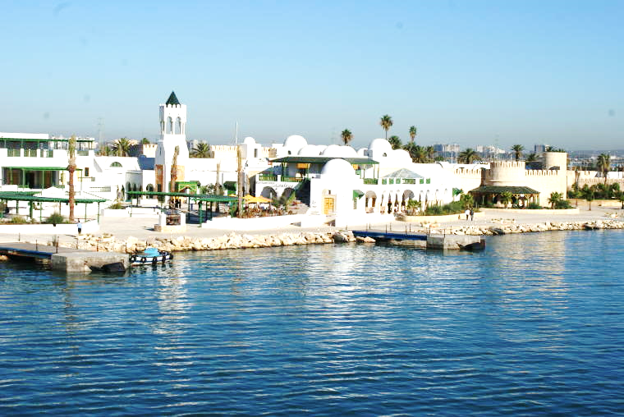
Restaurants - La Goulette

Slide 7
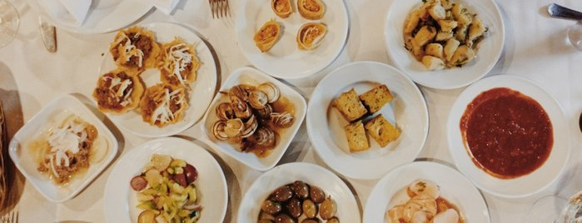
La Spigola, La Goulette
Ristorante La Spigola welcomes you in a family atmosphere, lively and convivial and offers specialties Seafood, Italian and Mediterranean.
Open everyday between 12:00 and 00:00
Reservation is a must.
Address: Rue Franklin Roosevelt, La Goullette
Tel: +216 71 738 345
Distance: 25 minutes drive
Dress Code: Smart Casual

Slide 8
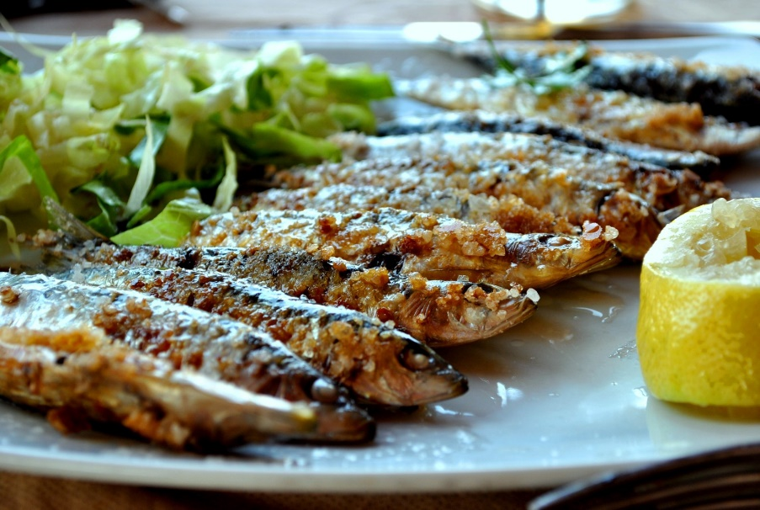
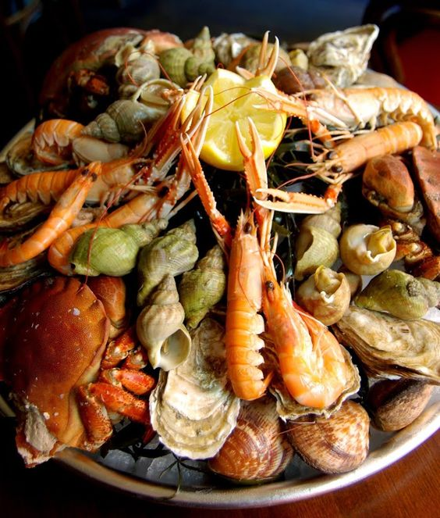
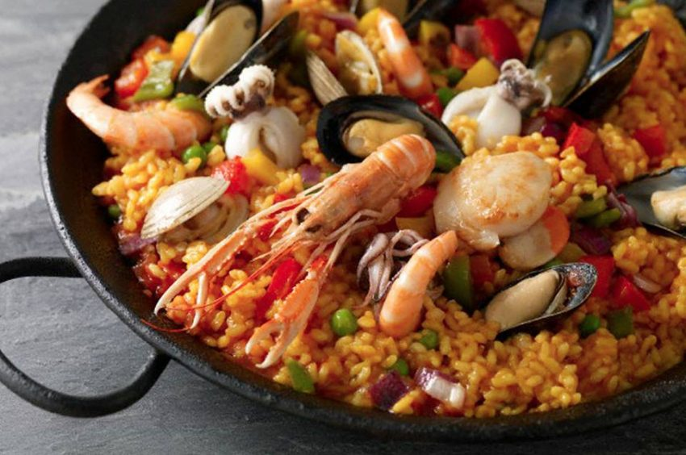
Le Café Vert, La Goulette
Good restaurant with typical Tunisian dishes. Excellent salad méchouia, calamares, seafood and bric with egg. Good atmosphere and service.
Open everyday between 12:00 and 00:00
Reservation is a must.
Address: 68, av. Franklin Roosevelt, la Goulette
Tel: +216 71 736 156
Distance: 25 minutes drive
Dress Code: Smart Casual

Slide 9
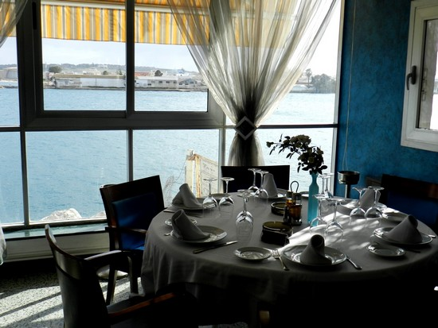
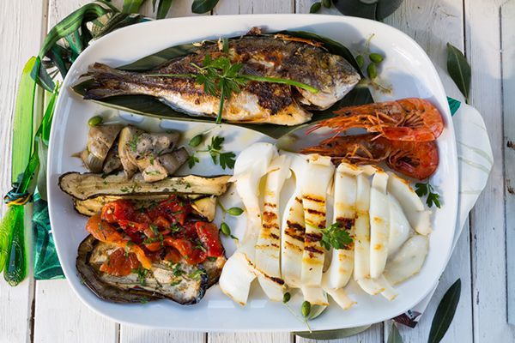
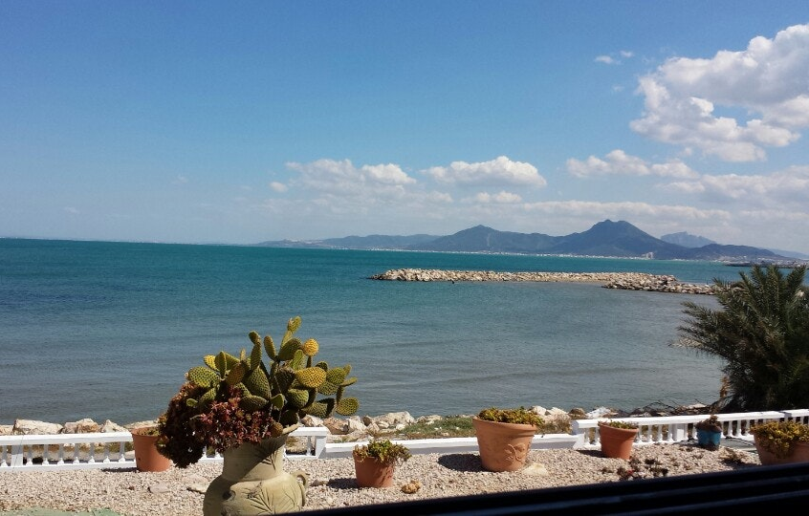
La Mer, La Goulette
The Restaurant La Mer welcomes you in a romantic, intimate and family atmosphere and offers Tunisian specialties and seafood.
Open everyday between 12:00 and 00:00
Reservation is a must.
Address: Rue Franklin Roosevelt, La Goullette
Tel: +216 71 735 802
Distance: 35 minutes drive
Dress Code: Smart Casual

Slide 10
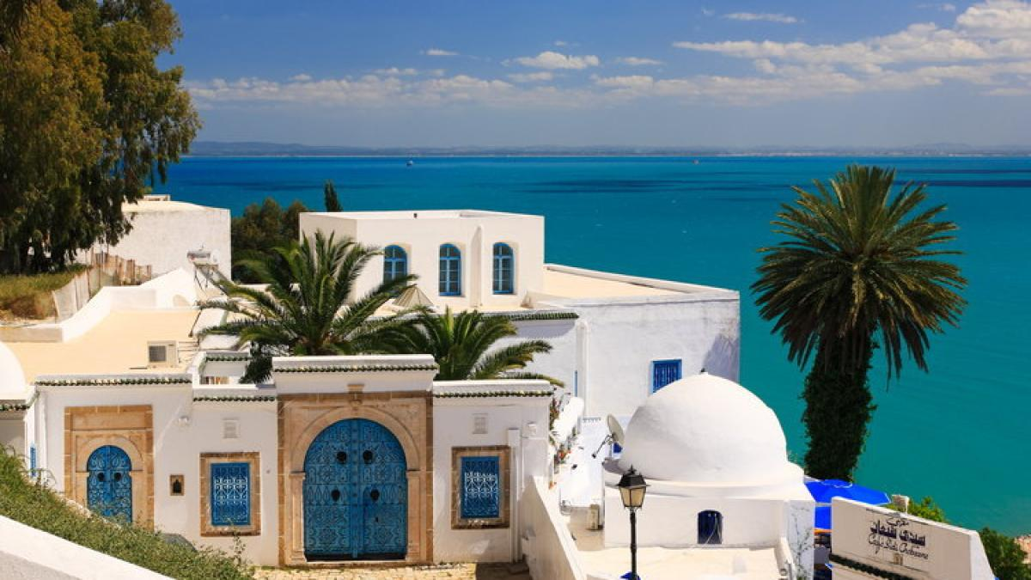
Restaurants - Sidi Bousaid

Slide 11
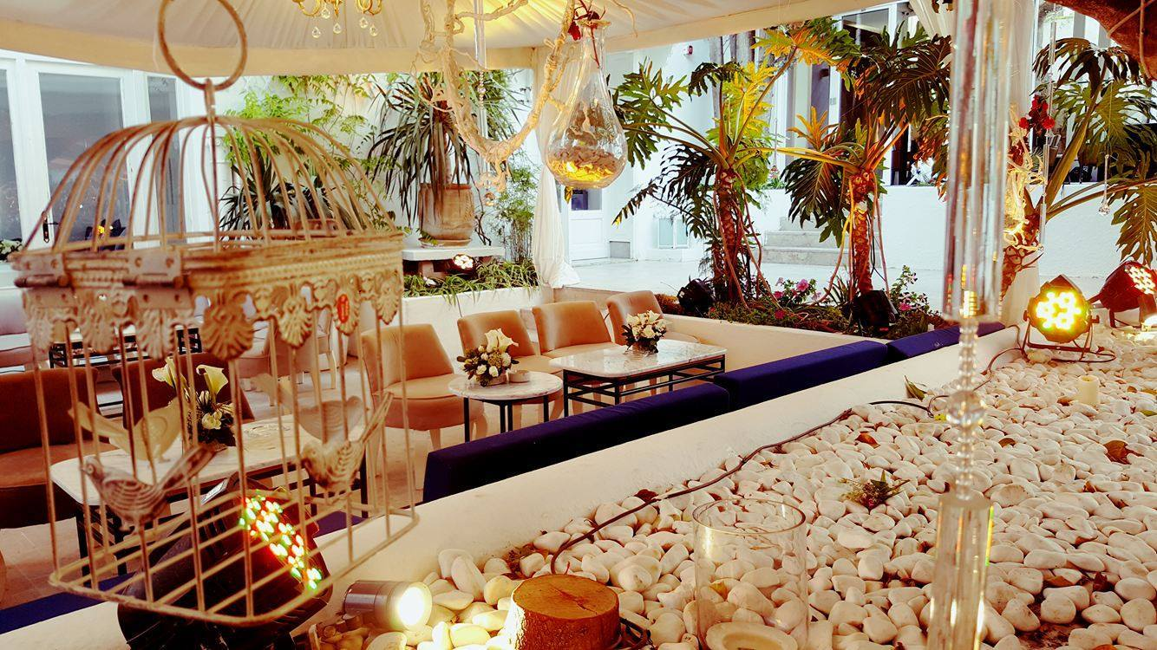
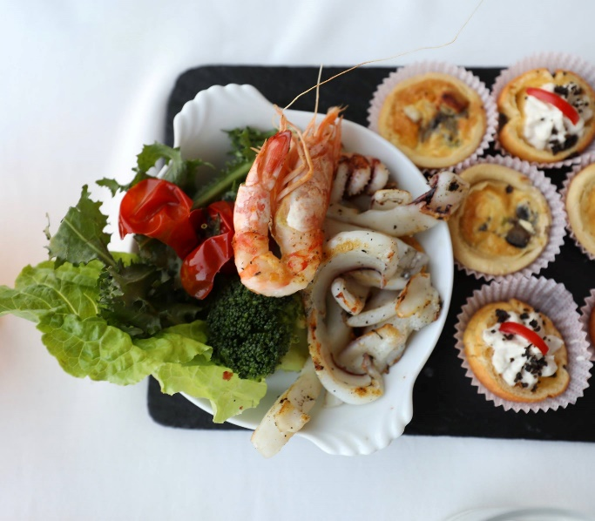
Dar Zarrouk, Sidi Bou Said
Dar Zarrouk, 3 forks, combines tradition and creativity, the style and sitting is unique and unusual open to the sea.
The kitchen is a crossroad between Tunisian and Mediterranean culinary traditions.
Open everyday except Monday between 12:00 and 23:00
Reservation is a must.
Address: Rue El Arbi Zarrouk , Sidi Bou Said
Tel: +216 71 740 591
Distance: 25 minutes drive
Dress code: Smart casual

Slide 12
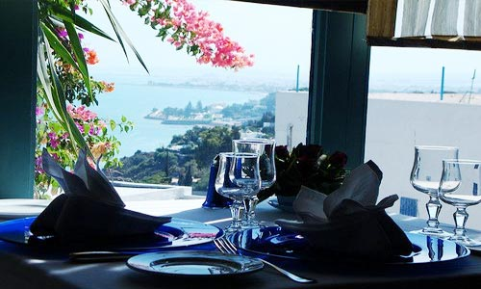
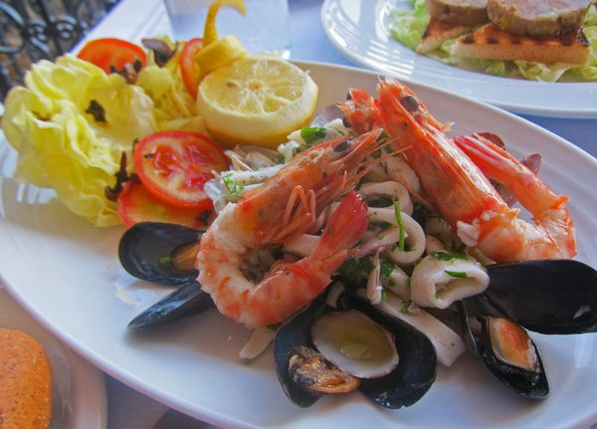
Au Bon Vieux Temps Sidi Bou Said
Known for its excellent seafood, and sophisticated takes on old standards, this is one of Tunis' most loved restaurants. Both the romantic terrace and elegant dining room have amazing big blue views.
Open everyday from 12:00 to 00:00
Reservation is a must.
Address: Rue Hedi Zarrouk, Sidi Bou Said
Tel: +216 71 744 733
Distance: 25 minutes drive
Dress Code: Smart Casual

Slide 13
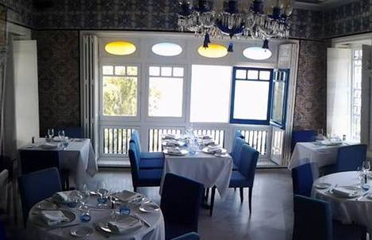
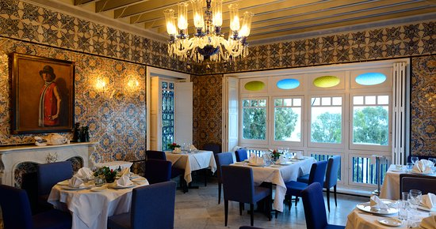
Restaurant La Villa Bleue
The gourmet restaurant welcomes you for lunch and dinner in its intimate setting to admire the sea view, enjoy the seasonal dishes and savor the recipes inspired by the local terroir.
Open from Tuesday to Sunday between 20:00 and 01:00
Reservation is a must.
Address: Rue Kennedy Sidi Bou Said
Tel: +216 71 742 000
Distance: 25 minutes drive
Dress Code: Smart Casual

Slide 14
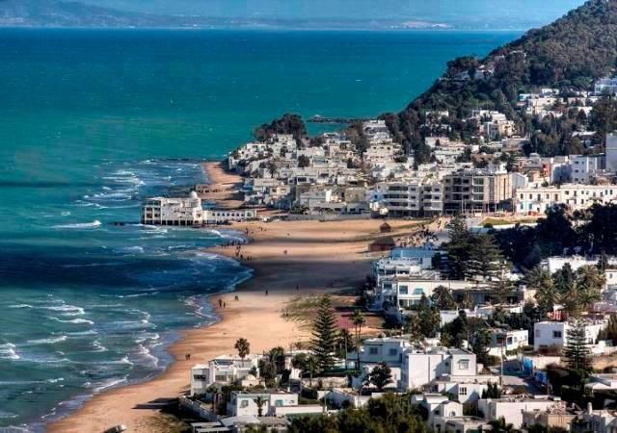
Restaurants - La Marsa

Slide 15
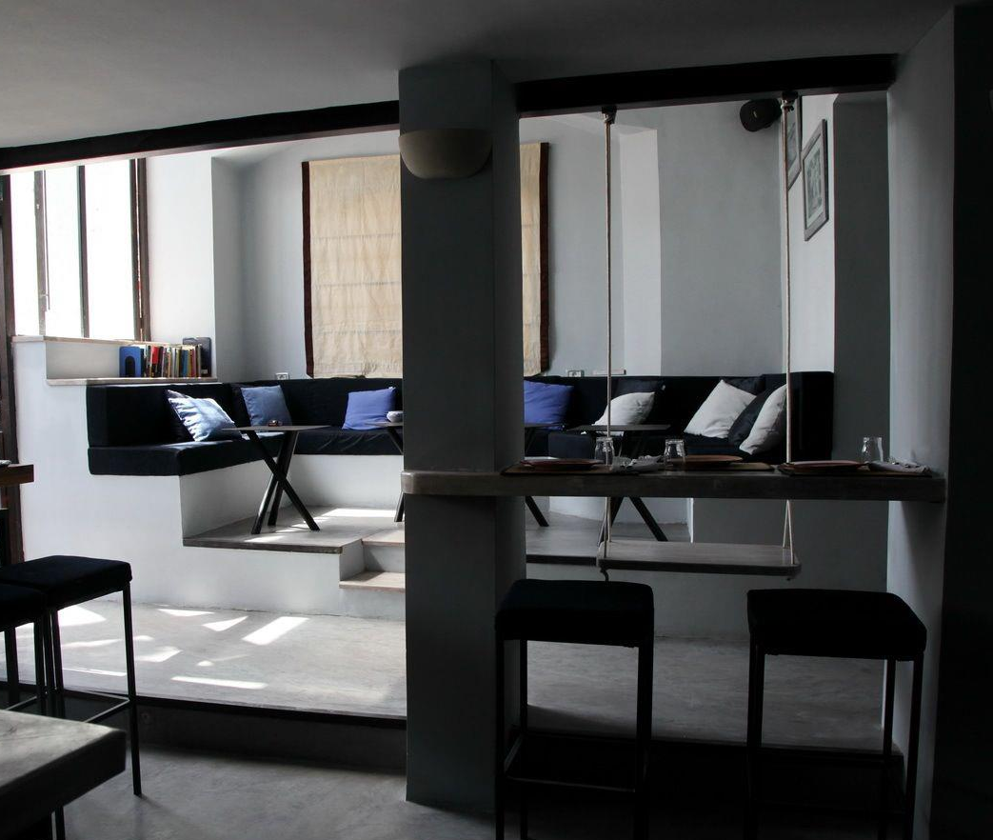
Au Bon Vieux Temps la Marsa
In the popular district of La Marsa, Au bon vieux temps restaurant offers a mix of different venues with good food and excellent atmosphere.
Italian cuisine is the focus of the menue.
Open everyday except Sunday between 12:00 and 00:00
Reservation is a must.
Address: Rue Abou-Kacem-Chebbi , La Marsa
Tel: +216 71 749 060
Distance: 15 minutes drive
Dress Code: Smart Casual

Slide 16
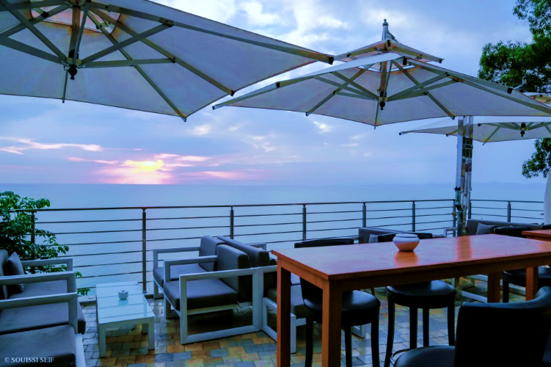
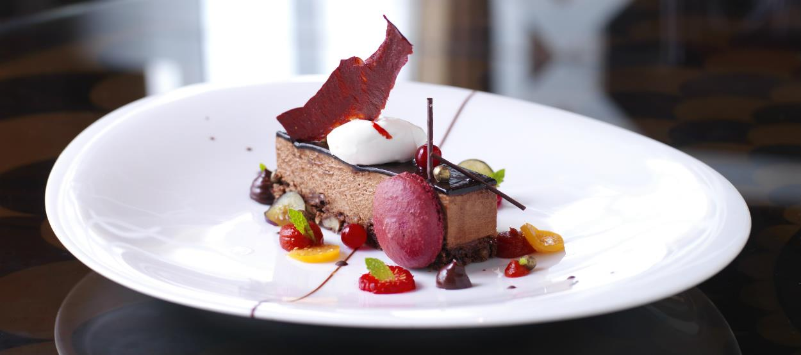
The Cliff
The Cliff is a restaurant located in La Marsa and offers Mediterranean, French and seafood cuisine. It has a terrace with sea view and access for disabled guests. The restaurant welcomes you in a romantic, chic and familiar ambience.
Open everyday between 12:00 and 01:00
Reservation is a must.
Address: R. Sidi Dhrif, la Corniche , La Marsa
Tel: +216 +216 24 777 040 / +216 71 980 179
Distance: 20 Minutes drive
Dress Code: Smart Casual

Slide 17
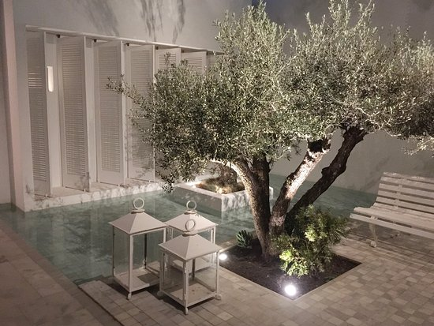
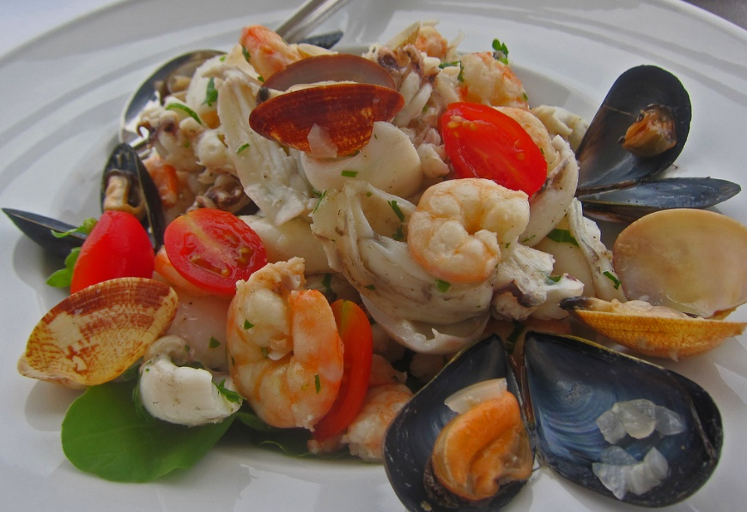
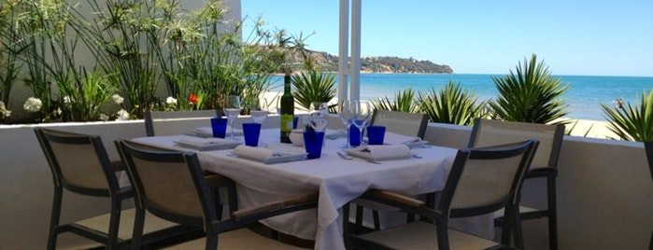
Le Golfe
Along the bay towards Gammarth, in a residential street, the modern decor and glamorous step-to-the-sand setting of this restaurant is a surprise.
Match dishes like grilled sardines, pasta with bottarga and steak with Montpellier butter with good local wines.
Open everyday from 12:00 to 00:00
Reservation is a must.
Address: Rue El Arbi Zarrouk , La Marsa
Tel: +216 71 748 219
Distance: 10 minutes drive
Dress Code: Smart Casual

Slide 18
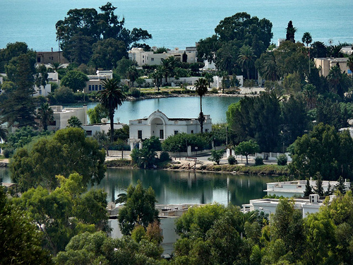
Restaurants - Carthage

Slide 19
The Restaurant of la Villa Didon
Overlooking the bay of Tunis, The restaurant of La Villa Didon is a panoramic area with an open kitchen where the singular ways of cooking permit the creation of multiethnic dishes where cultures and ingredients tastefully meet. A unique selection of international and tunisian wines shall accompany your culinary wanderings.
Open everyday between 12:00 - 15:00 and 20:00 – 23:00
Reservation is a must.
Address: Street Mendes France, Carthage Byrsa
Tel: +216 71 733 433
Distance: 20 minutes drive
Dress Code: Smart Casual

Slide 20
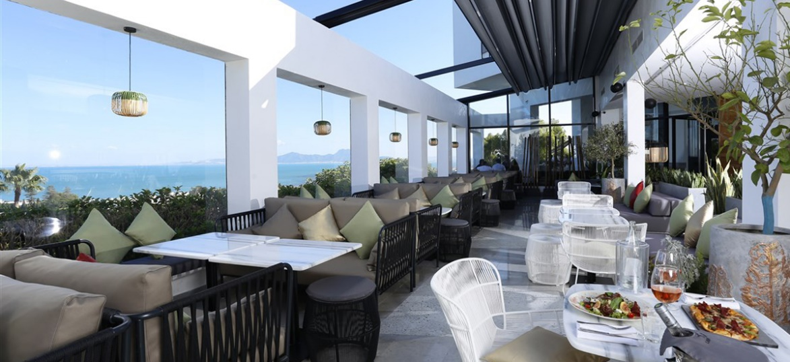
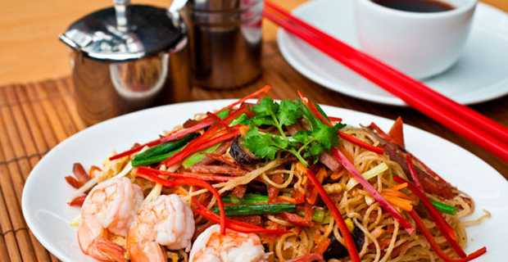
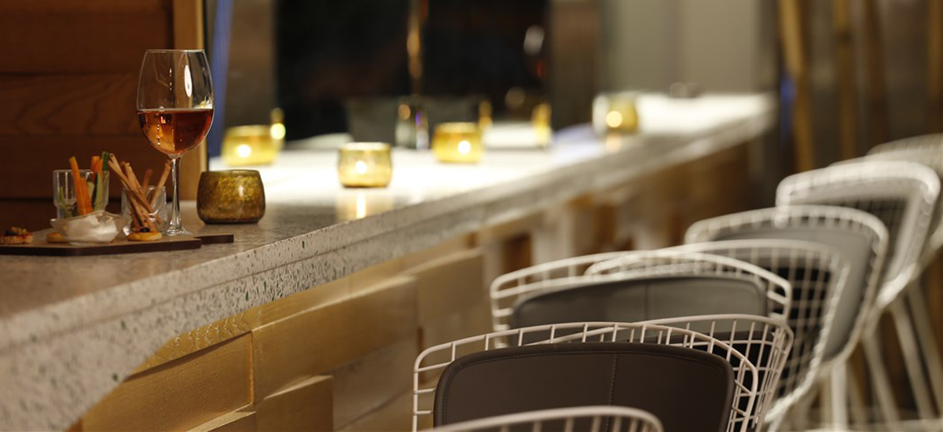
Le perchoir of la Villa Didon
Perched on the hill of Carthage, this lounge bar covered with greenery such as a garden of Eden is the ideal place for a casual drink.
Le Perchoir offers you an Asian card.
Open everyday between 12:00 - 15:00 and 20:00 – 23:00
Reservation is a must.
Address: Street Mendes France, Carthage Byrsa
Tel: +216 71 733 433
Distance: 20 minutes drive
Dress Code: Smart Casual

Slide 21
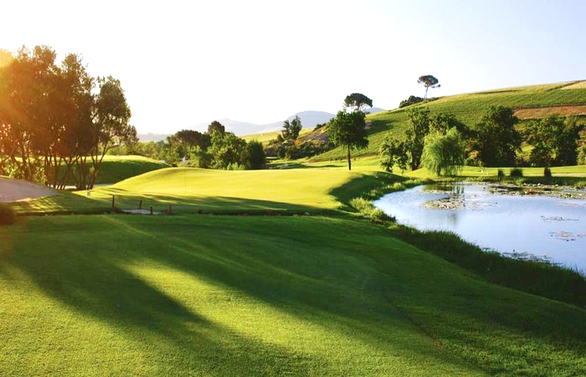
Restaurants – La Soukra

Slide 22
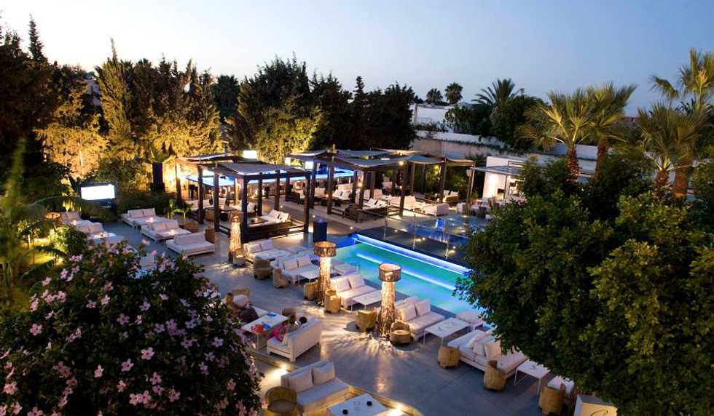
La Closerie, La Soukra
La Closerie is one of the best restaurant that allows you to escape the city's hectic lifestyle with a spirit, an atmosphere, a symbiosis that comes from the encounter between a gourmet and refined Italian-Mediterranean cuisine.
Open everyday except Monday between 12:00 and 00:00
Reservation is a must.
Address: Km.16,Sidi Fredj La Soukra
Tel: +216 70 938 537
Distance: 20 minutes drive
Dress Code: Smart Casual

Slide 23
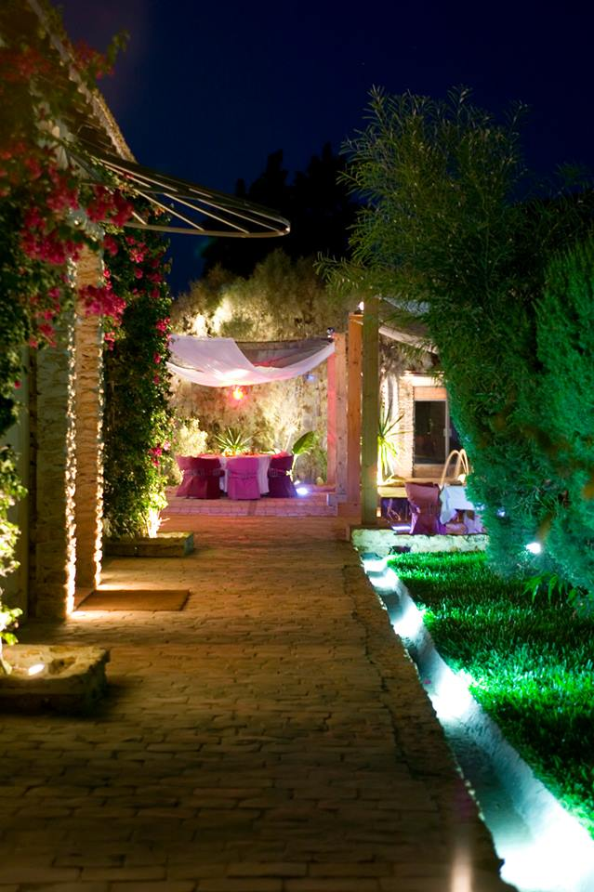
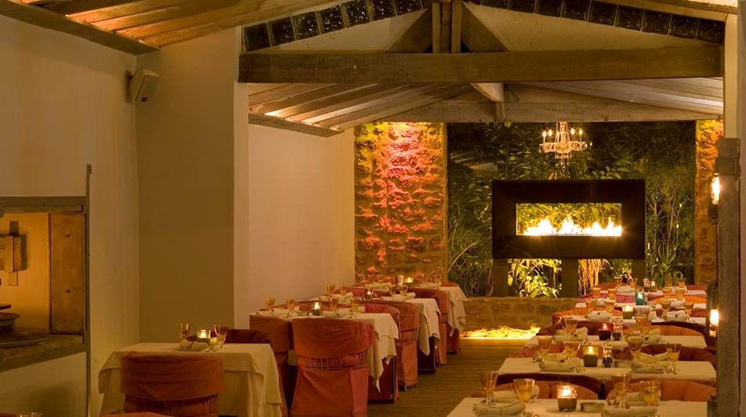
El Firma, La Soukra
El Firma is 1920s farmhouse setting, mysteriously out of the way and walled by towering eucalypts and the much-hyped contemporary menu is ironically ‘80s.
The restaurant offers a refind Mediterranean cuisine.
Open from Tuesday to Sunday between 20:00 and 01:00
Reservation is a must.
Address: R. des Fruits,Choutrana III , Tunis
Tel: +216 71 863 089
Distance: 25 minutes drive
Dress Code: Smart Casual

Slide 24
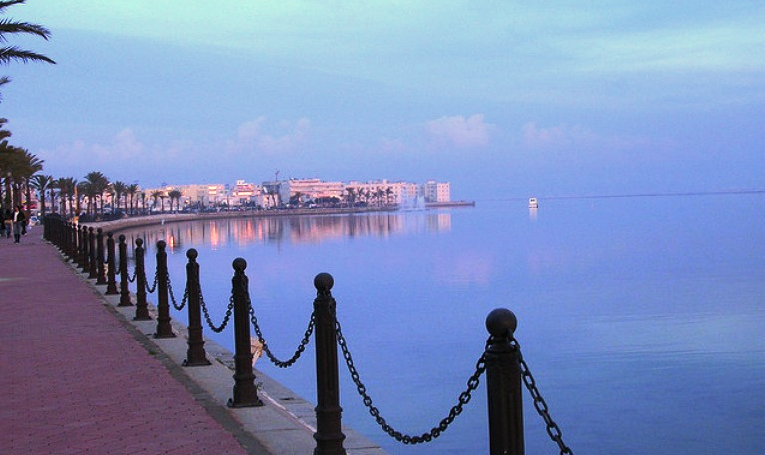
Restaurants – Les Berges duLac

Slide 25
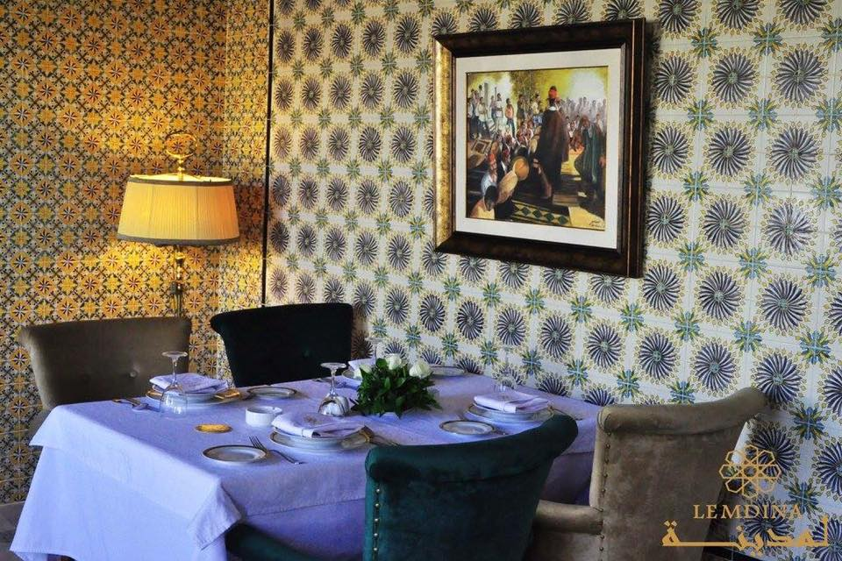
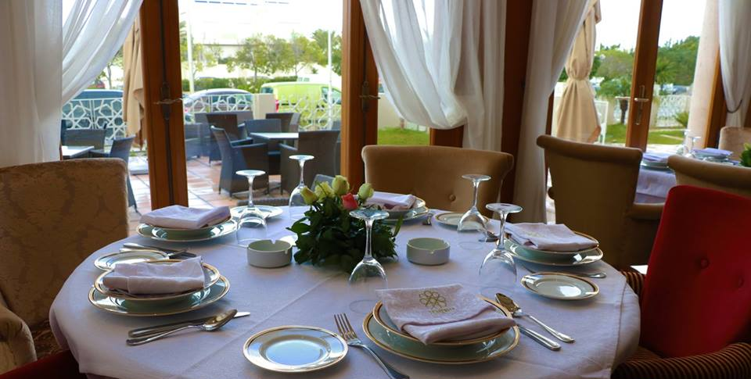
Lemdina, Les berges du Lac I
Located at Lac 1, at Habib Achour Avenue. Lemdina combines the setting and cozy atmosphere of its tea room with a unique atmosphere inspired by typical Tunisian décor.
Open from Monday to Saturday between 08:00 and 22:00
Reservation is a must.
Address: Les Berges du Lac 1 à coté hotel Acropole ,Tunis, Tunisia
Tel: +216 55 113 333
Distance: 25 minutes drive
Dress Code: Smart Casual

