Slide 1
DISCRETE COMPLEX ANALYSIS
FELIX GÜNTHER
GERMANY
INSTITUT DES HAUTES ÉTUDES SCIENTIFIQUES
Notes:
1

Slide 2
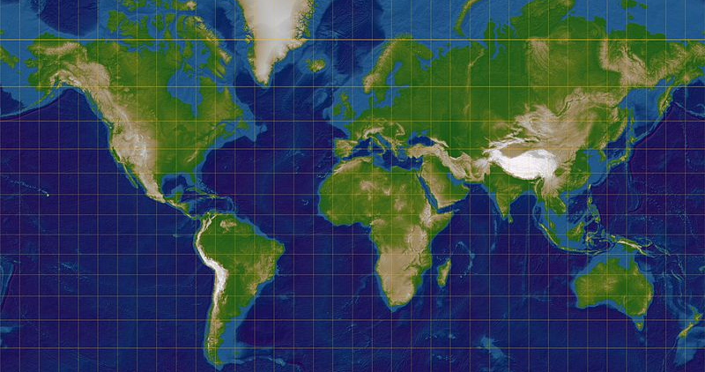
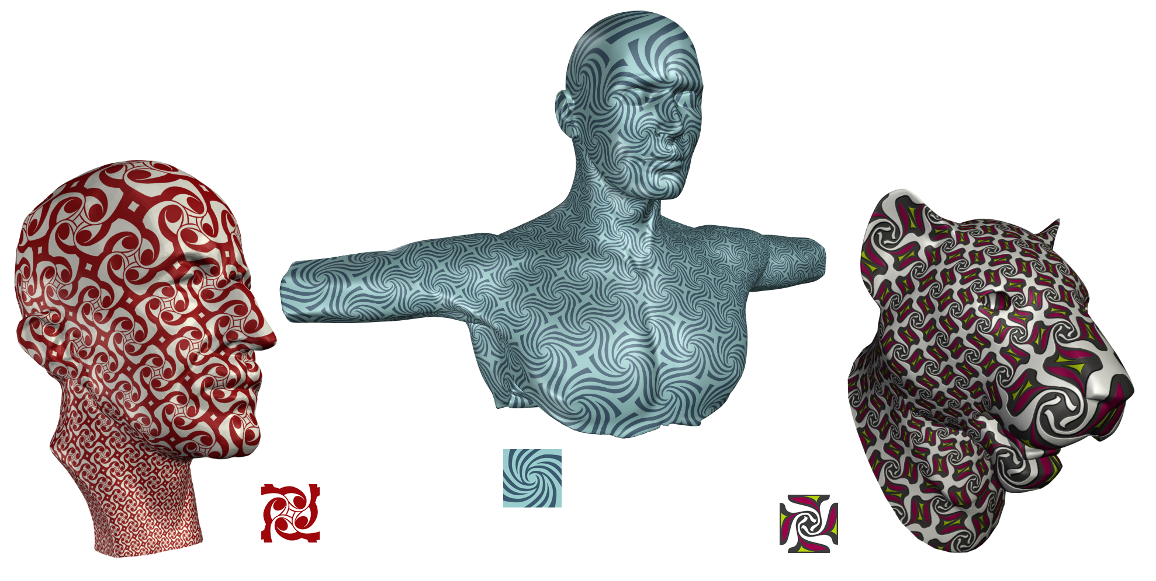
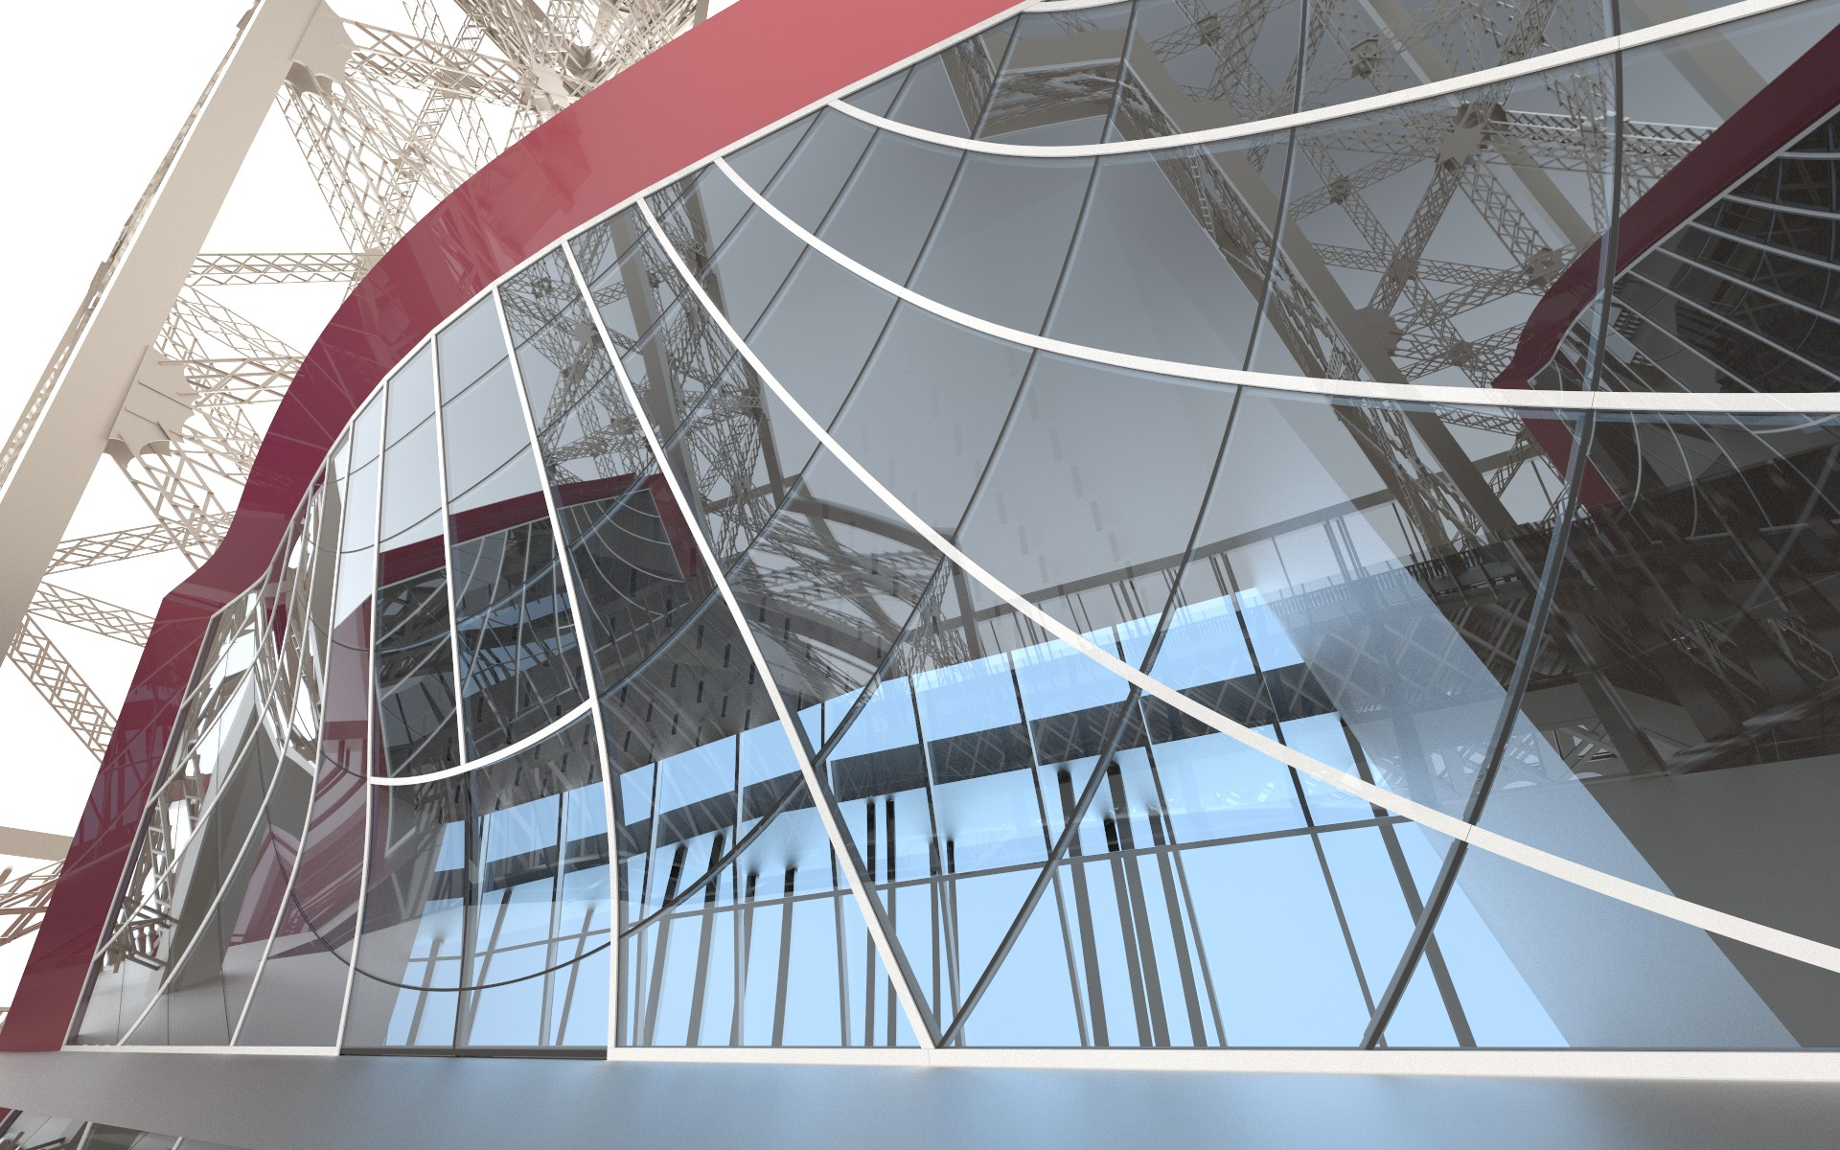
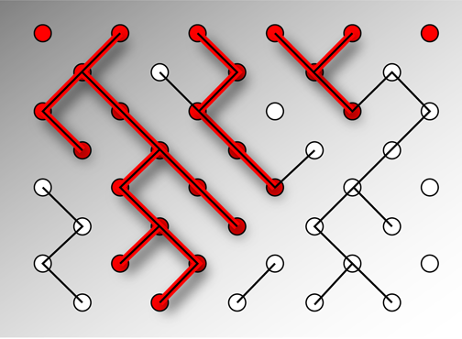
FELIX GÜNTHER
BREAKING THE WALL OF DISCRETE COMPLEX ANALYSIS

Slide 3
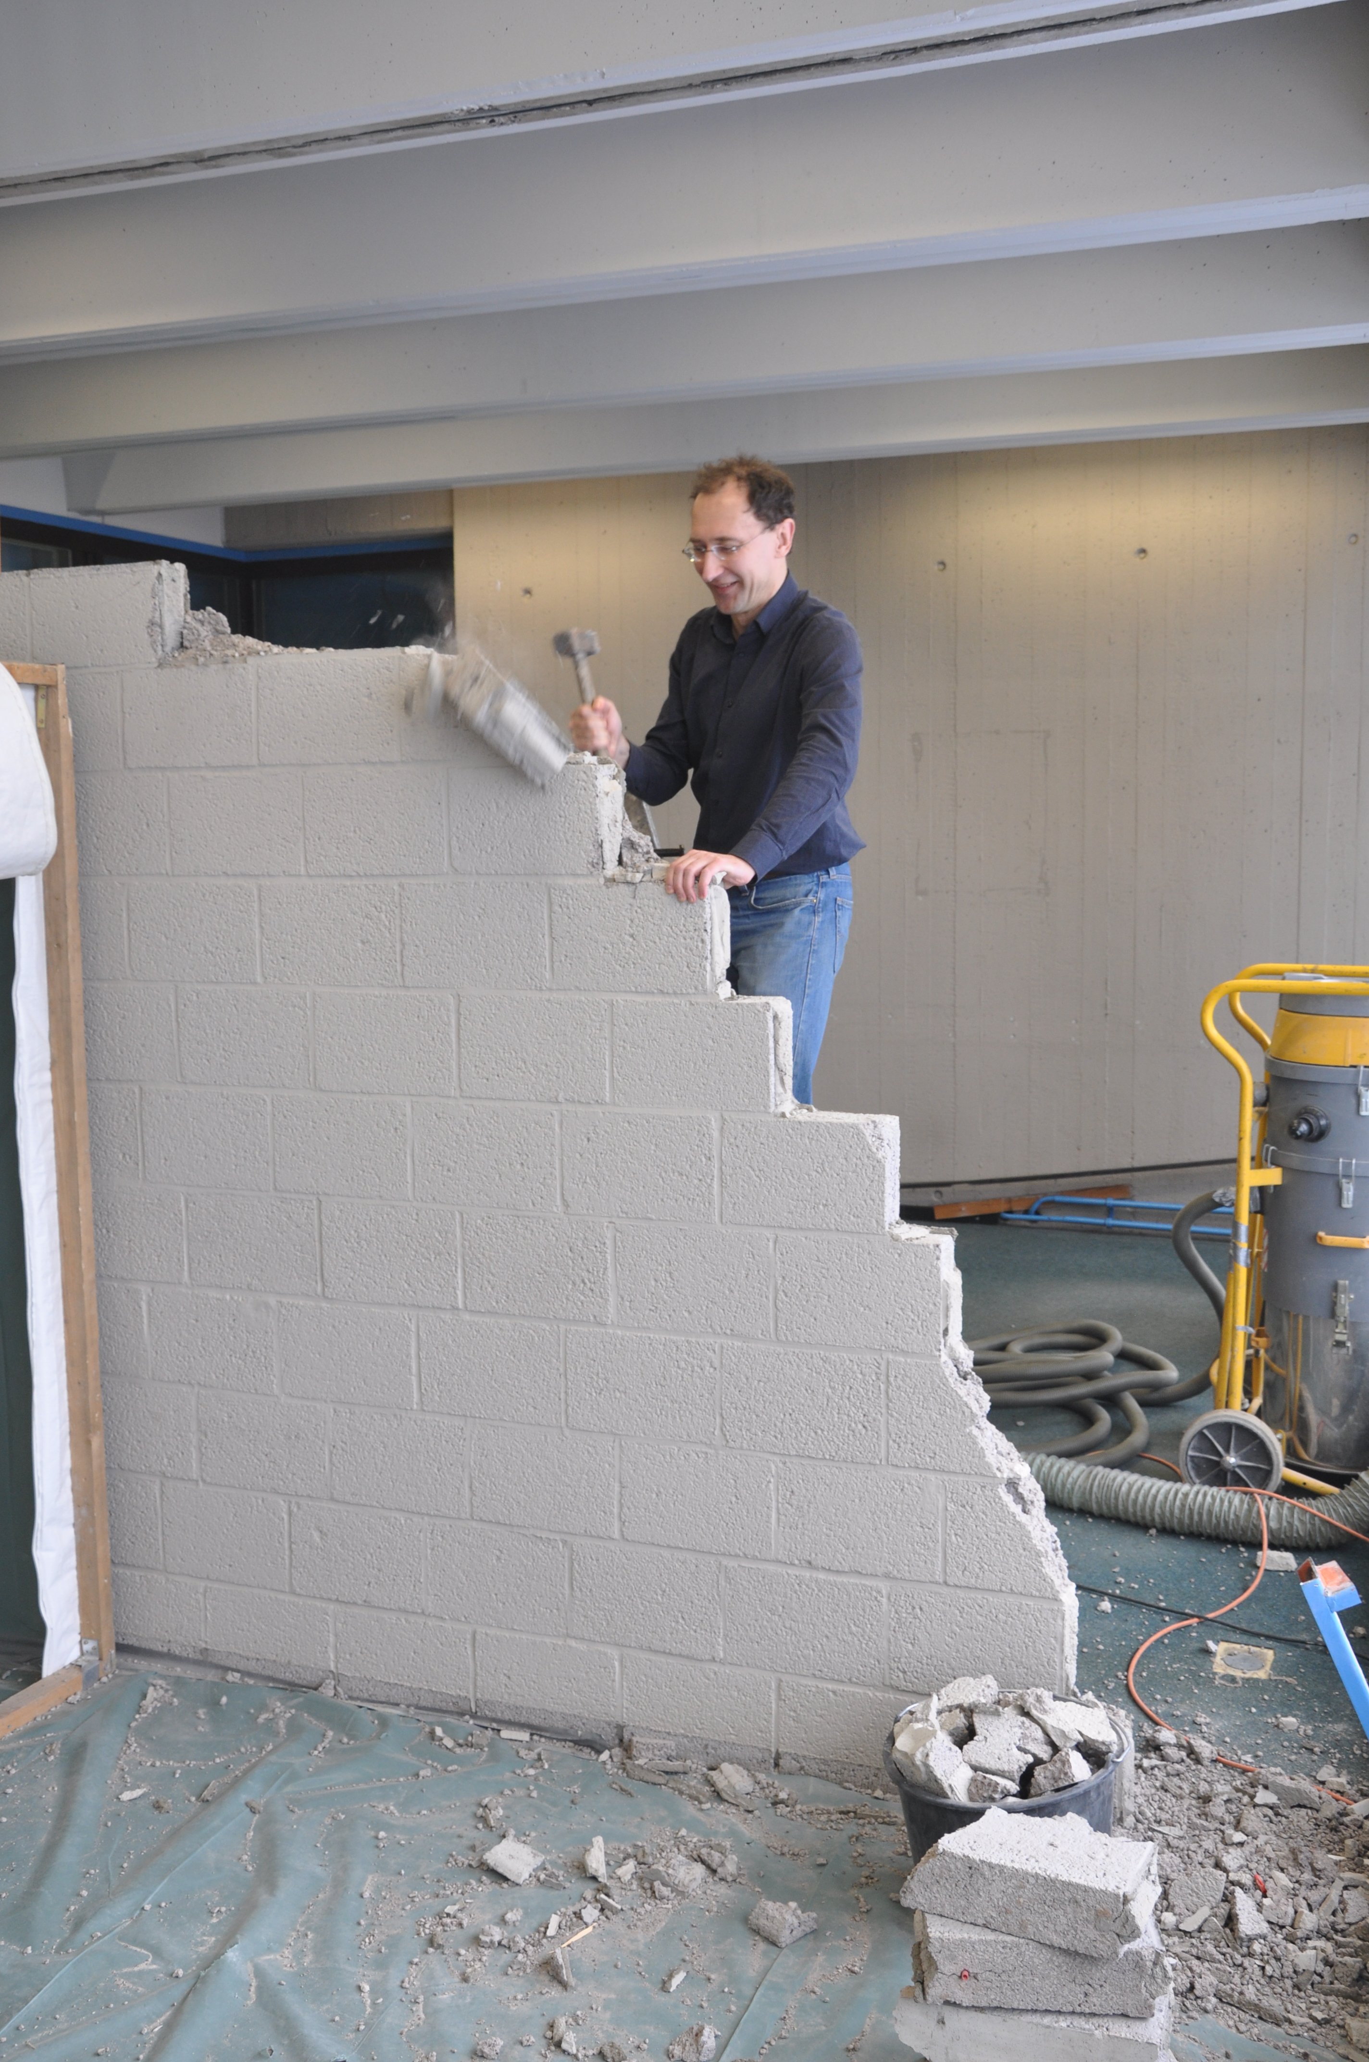
FELIX GÜNTHER
BREAKING THE WALL OF DISCRETE COMPLEX ANALYSIS

